Slide 1

PHYSICAL EDUCATION
2017-2018

Slide 2

MEET THE STAFF

Slide 3
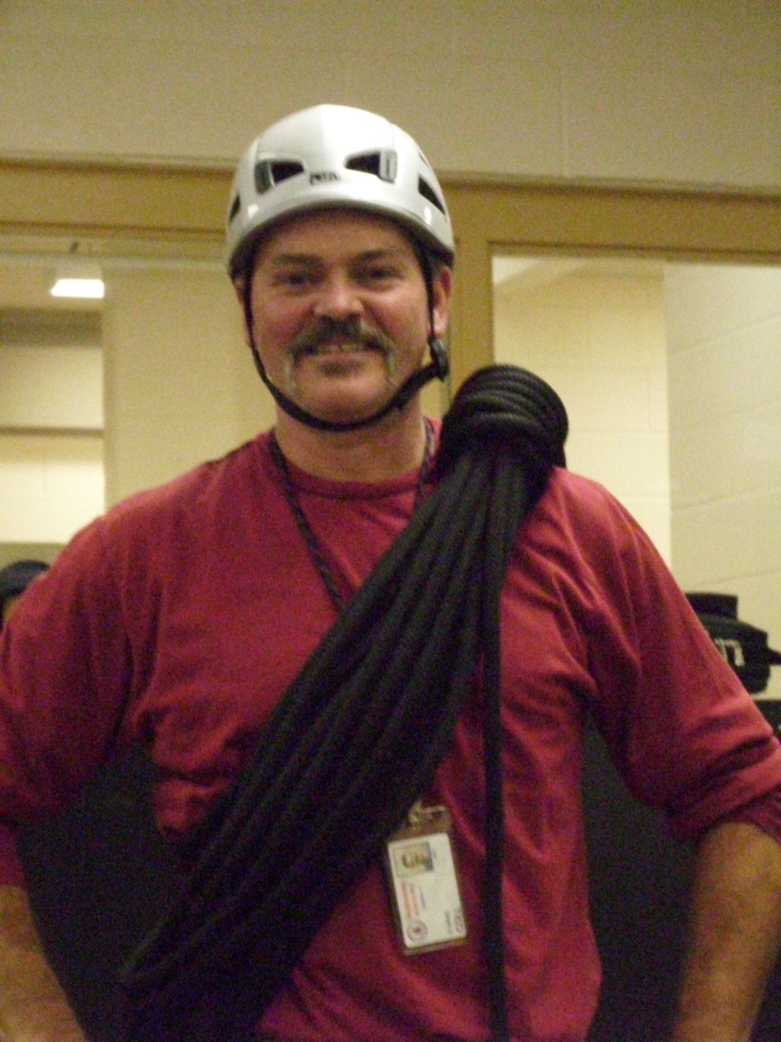
MR. COLL

Slide 4

MRS. GERUC

Slide 5

MS. JOHNSON

Slide 6
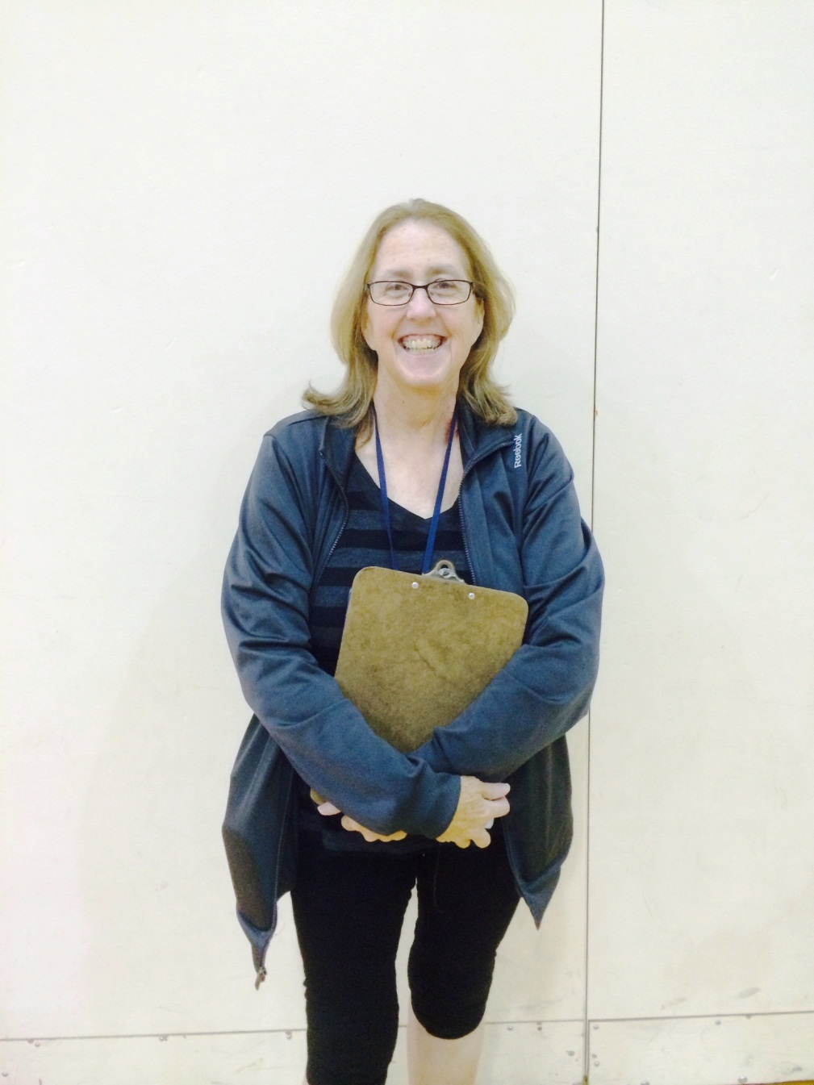
MRS. KING

Slide 7
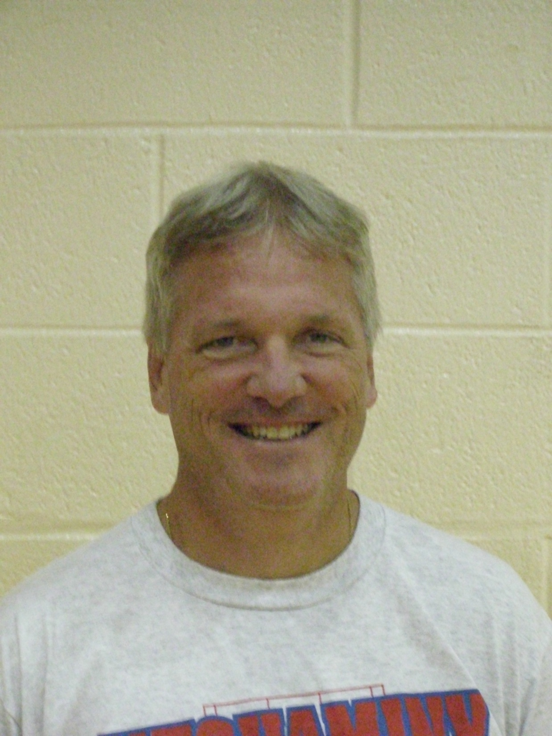
MR. PLACE

Slide 8
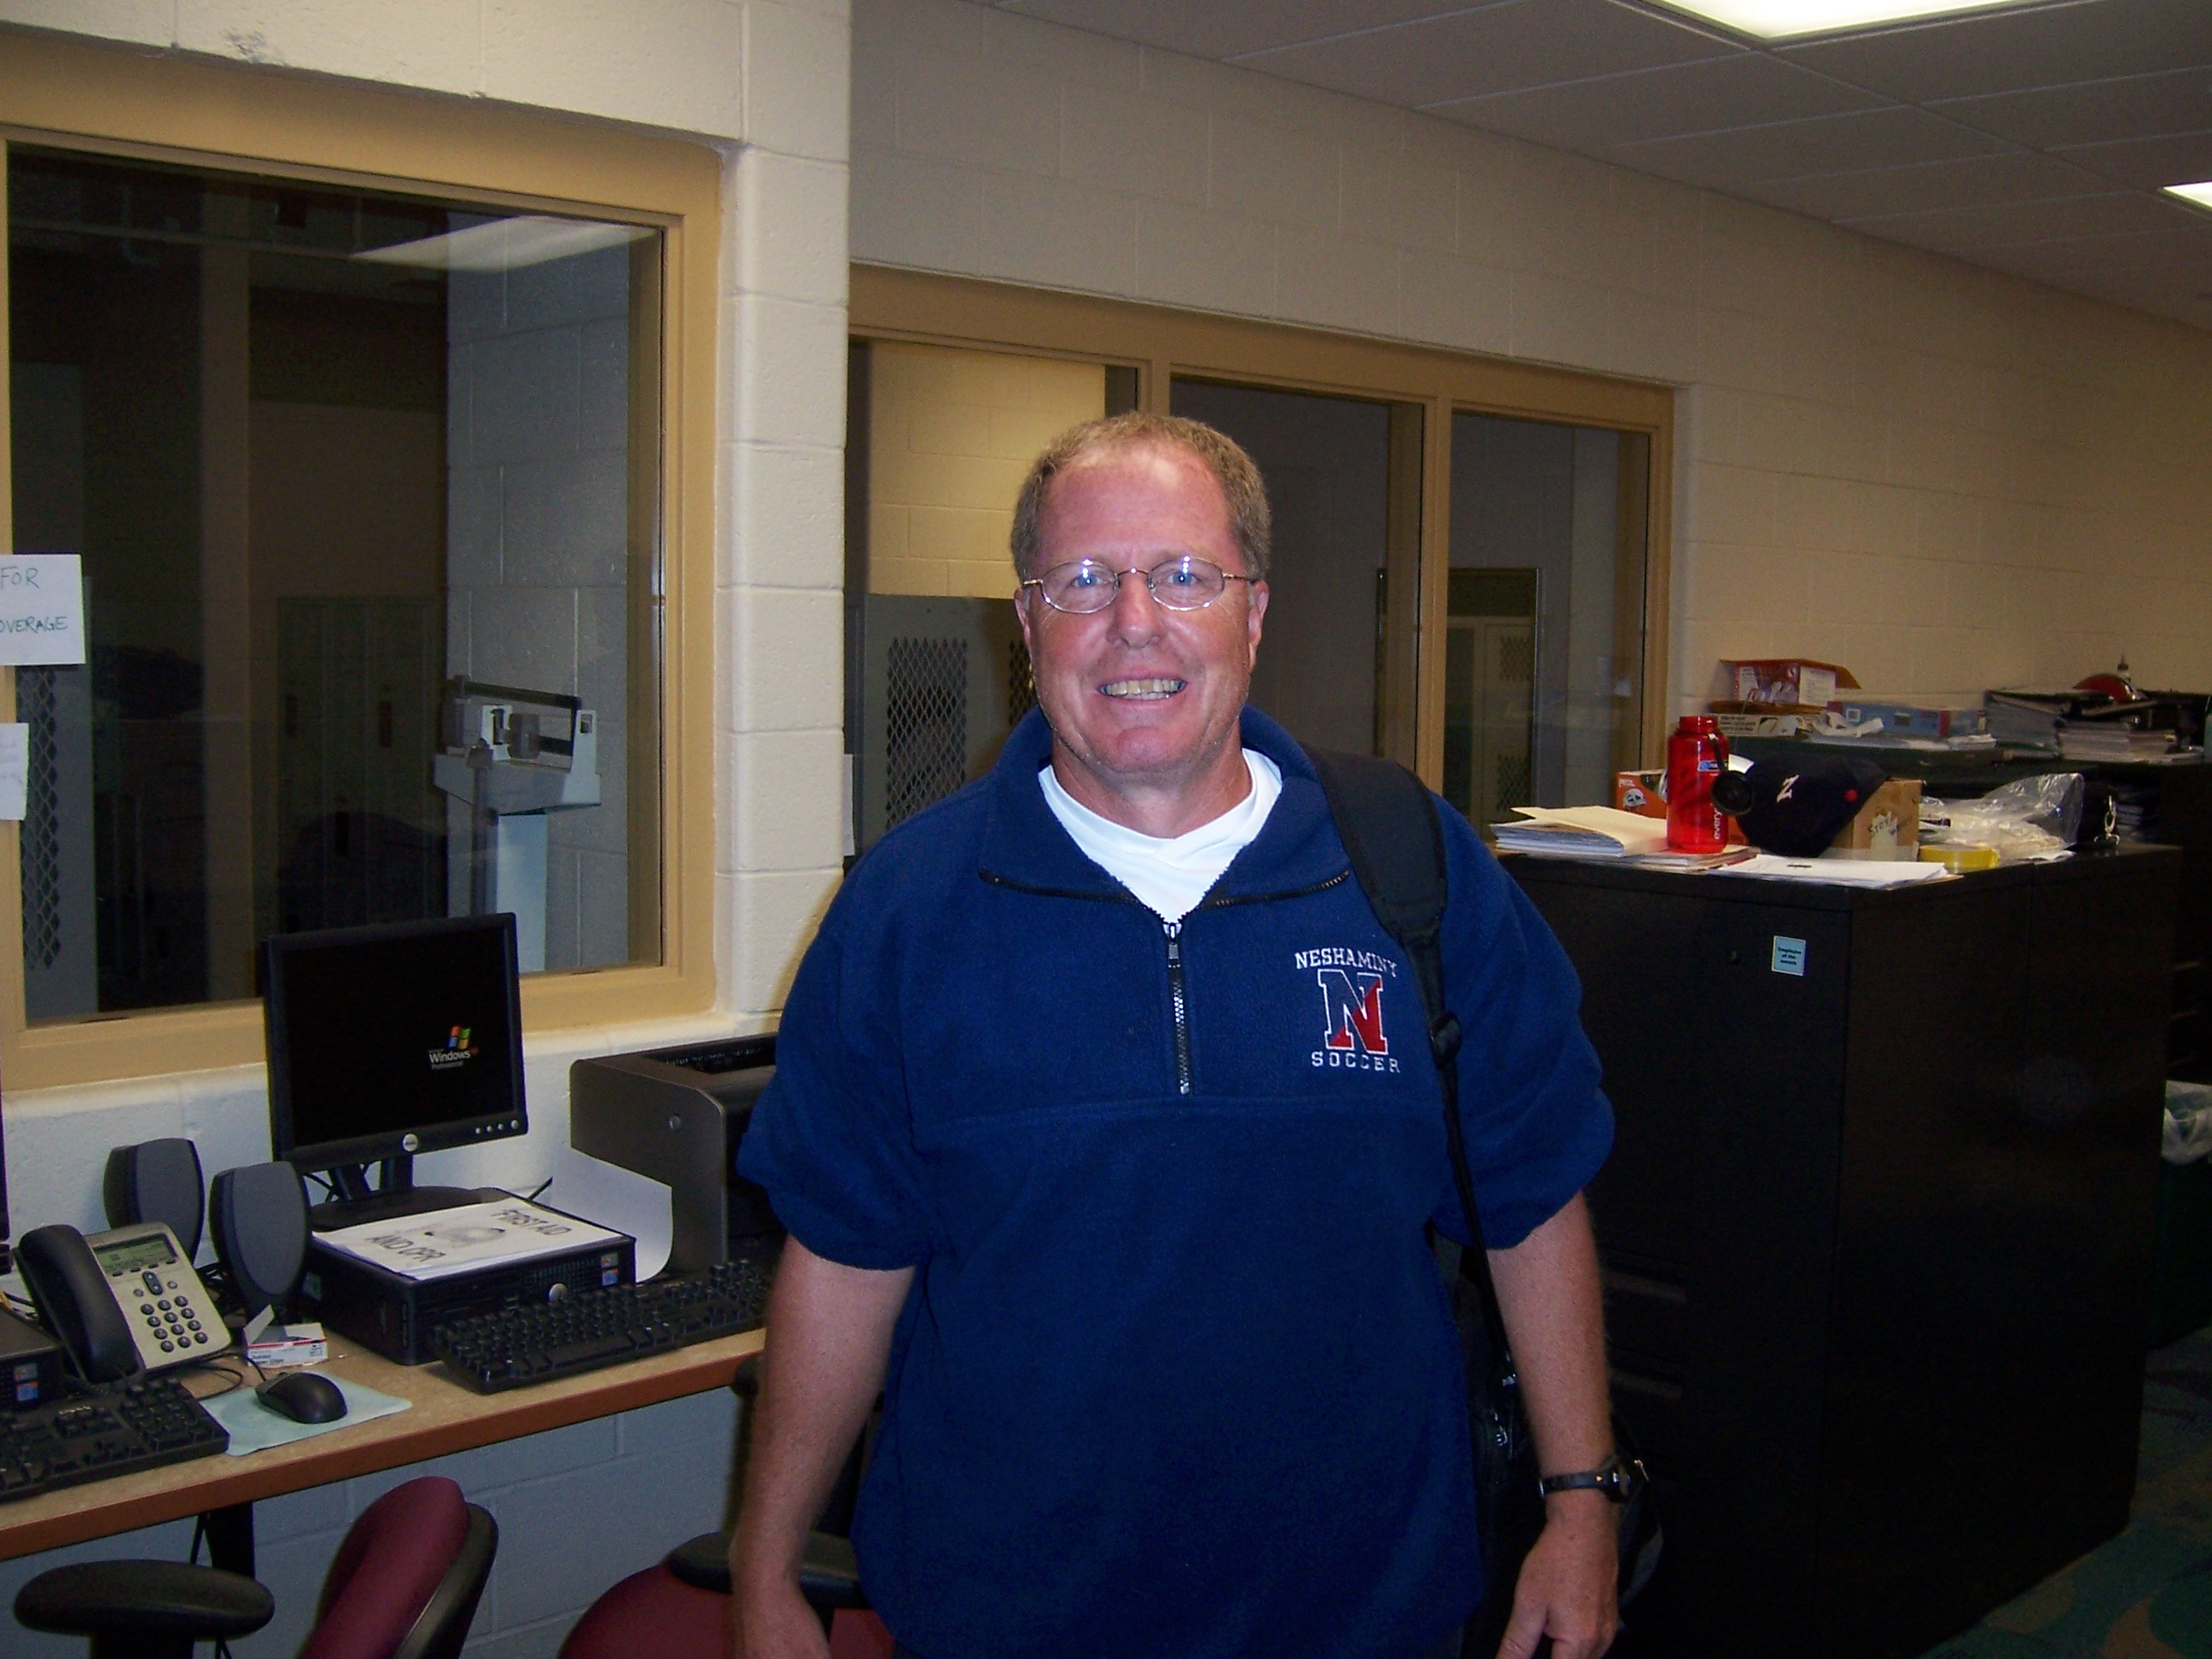
MR. REICE

Slide 9
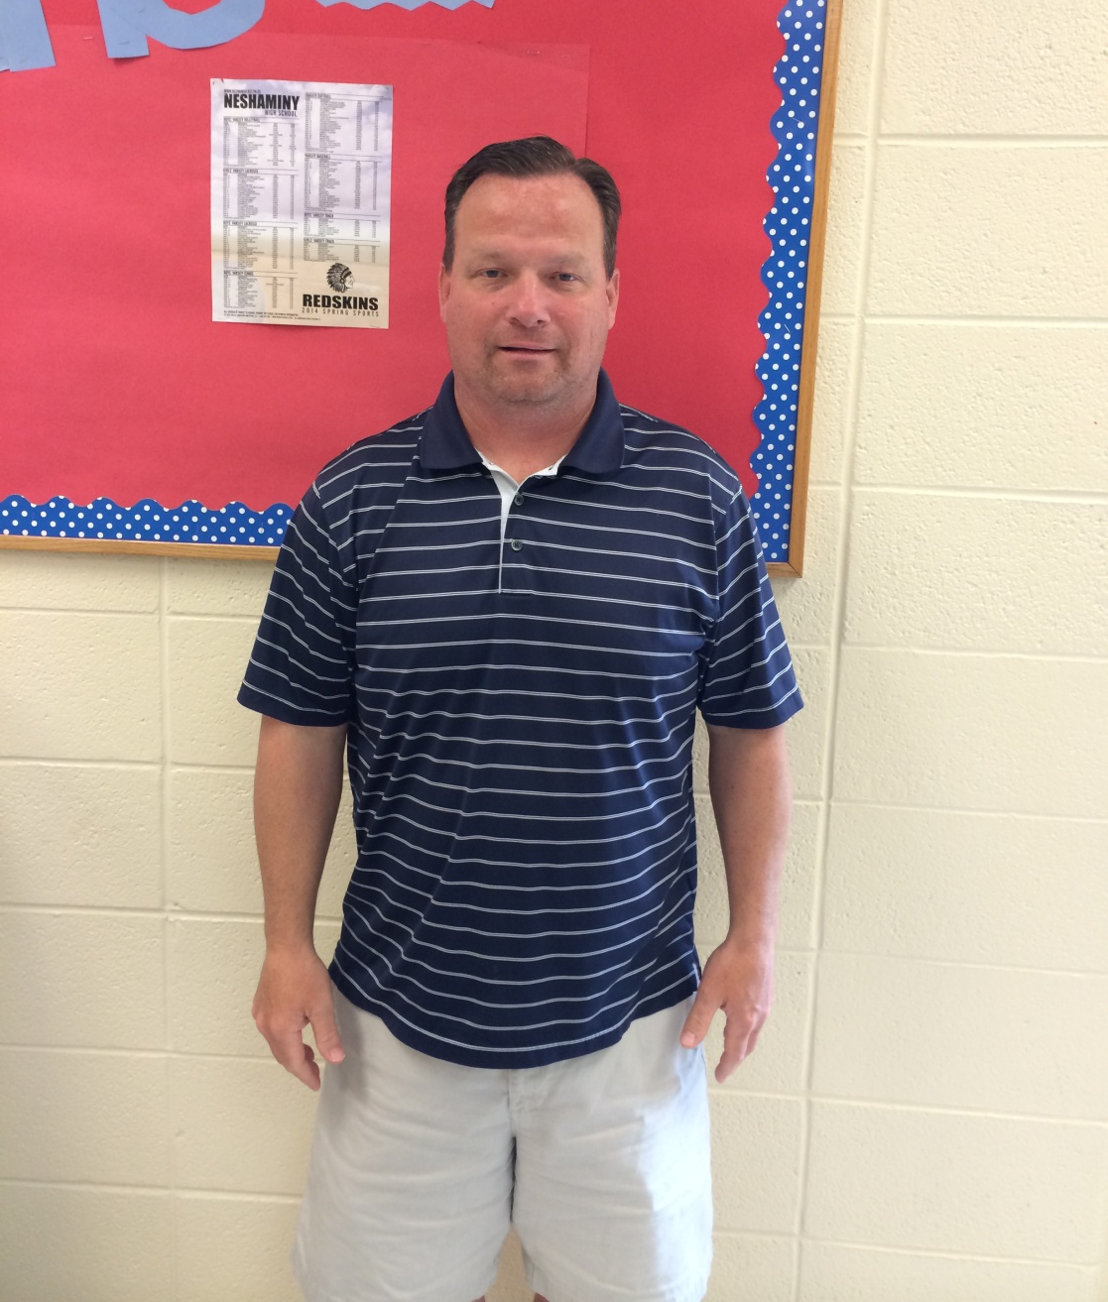
MR. SMITH

Slide 10

MR. TENAGLIA

Slide 11

MR. WEIDENBAUGH

Slide 12
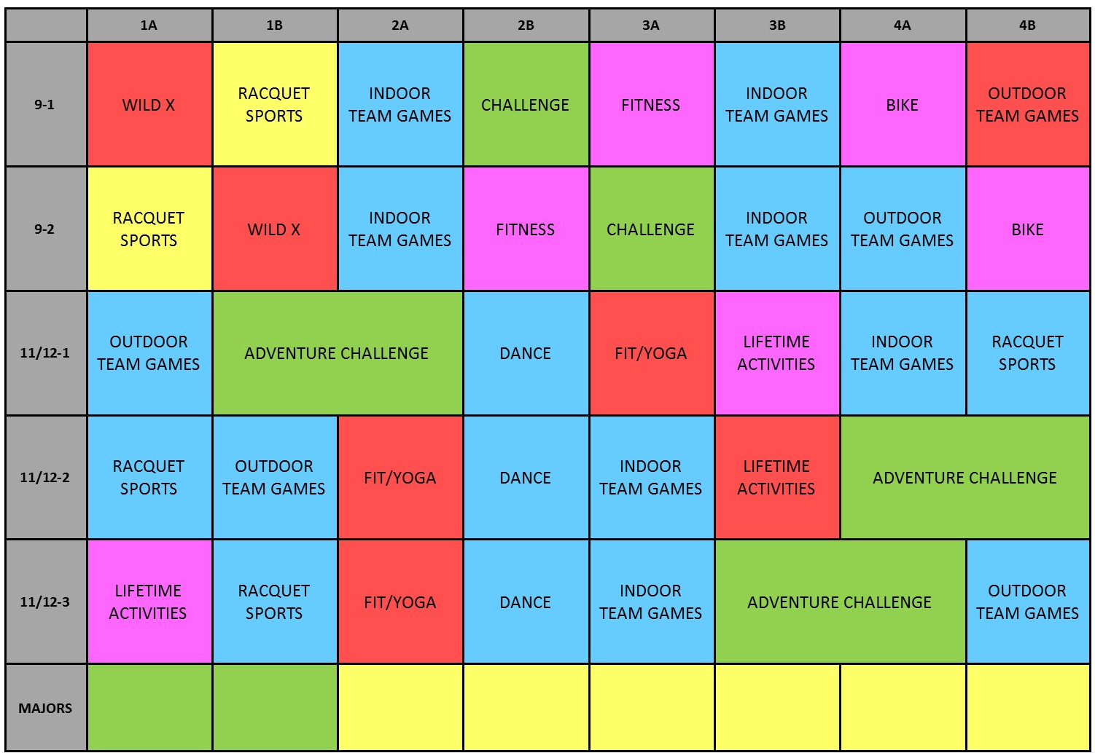
PHYSICAL EDUCATION ACTIVITY GRID 2017 - 2018

Slide 13

YOUR GRADE
Active Involvement in Learning and Class Activities
Safe Practices and Appropriate Clothing
Working with Others
Strategies and Tactical Concepts
Skill Improvement
Class Assignments and Assessments

Slide 14
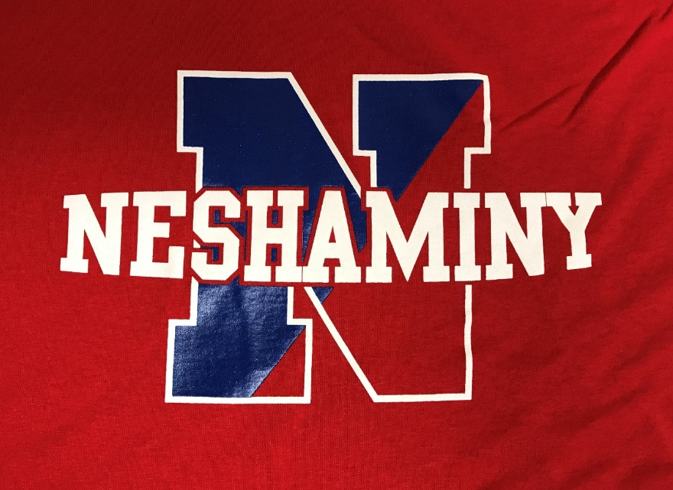

RED SHIRT = 1 POINT
ALL PE CLASSES
WILL BE REQUIRED
TO WEAR A RED SHIRT

Slide 15
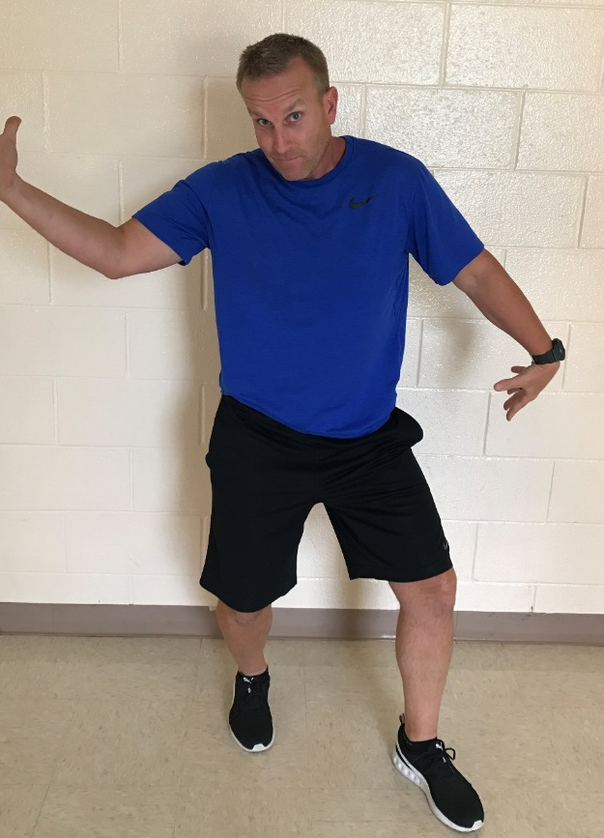
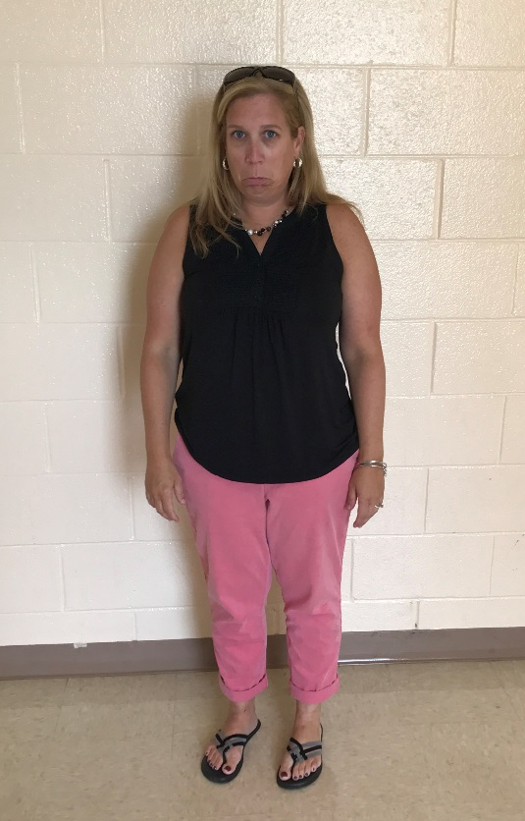
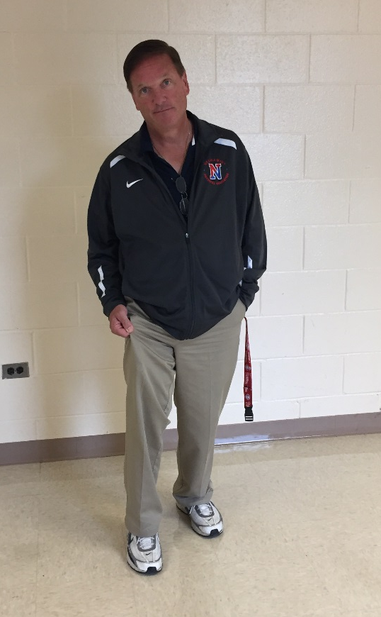
STUDENT #1
0 points
-NO SNEAKERS
-FLIP FLOPS
-NO SHORTS
STUDENT #2
7 points
-SNEAKERS
-NO SHORTS
-NO T-SHIRT
STUDENT #3
9 points
-SNEAKERS
-Athletic Bottoms
-NO RED SHIRT
WARM-UP = 2 points
*standard daily points

Slide 16
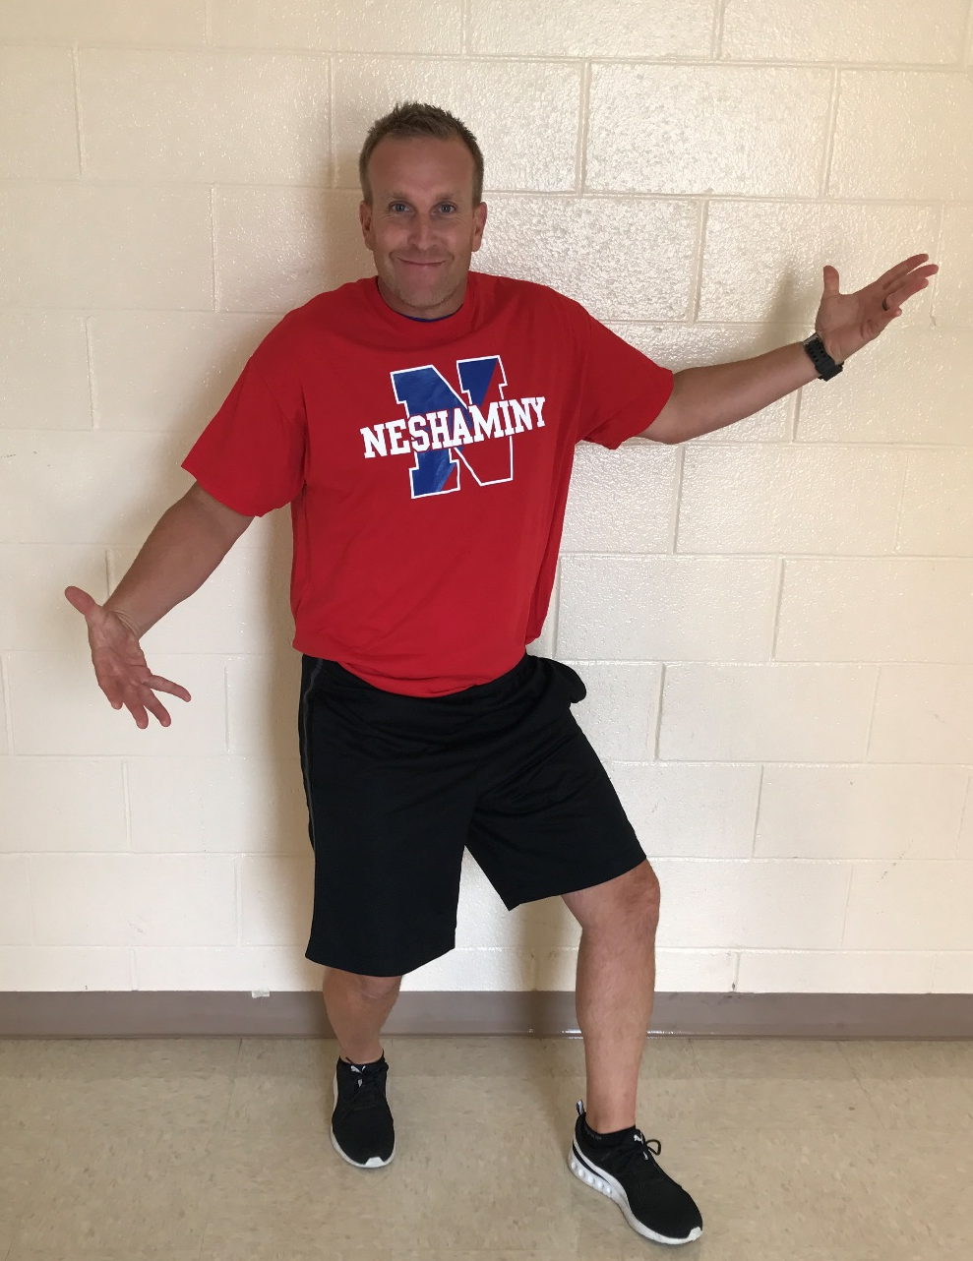

STUDENT #4
10 points
-SNEAKERS
-Athletic Bottoms
-RED T-SHIRT

Slide 17

UNAPPROVED
Jeggings
Flip Flops
Jeans
Uggs
Sperrys
“There’s red in my shirt”

Slide 18
PE PROCEDURES
BEGINNING CLASS
  All students will report to GYM 3 for Warm Up and Roll Call.
    5 Minutes after bell rings to get there
      You WILL BE MARKED LATE.
  Locker Room doors locked during class time.

Slide 19

WARM-UPS
Required for each Phys. Ed class.
Exceptions: Biking and Challenge will report directly to their teacher.
Warm Up Points:
2 out of your 10 possible points are earned in
the warm up.

Slide 20
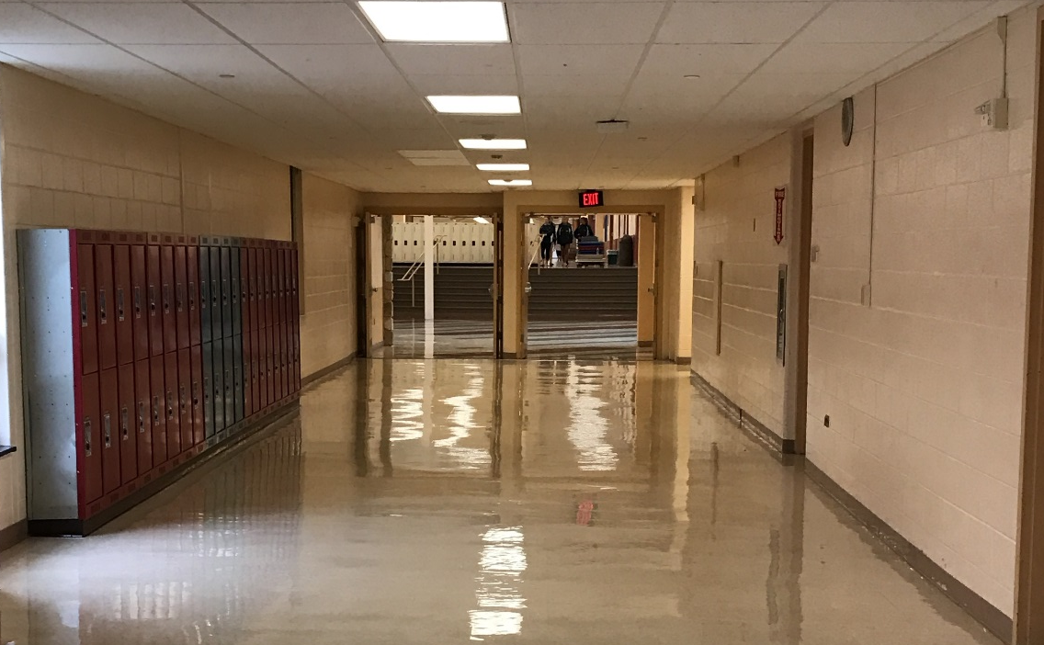

END OF CLASS
Gather your belonging and you may head into J-hall until till the bell rings.
    DO NOT GO THROUGH CAFETERIA DOORS

Slide 21

LOCKS
  Provide own and use it!
  Lock all valuables, school not responsible
  People WILL steal unlocked items

Slide 22
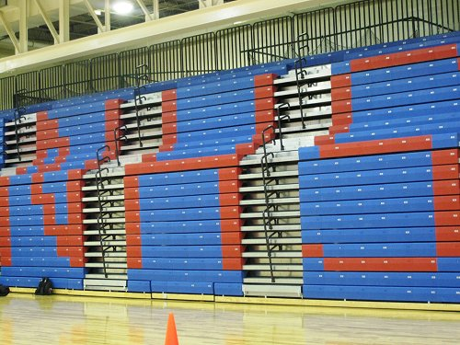

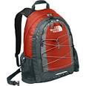
BOOK BAGS AND PERSONAL ITEMS
MUST REMAIN IN THE
LOCKER ROOM
AT ALL TIMES!

Slide 23

BACKPACKS
1st Offense: Warning
2nd Offense: Call Home
3rd Offense & Beyond: Write-Up for Insubordination

Slide 24

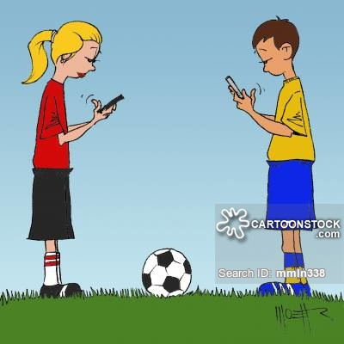
ENOUGH SAID

Slide 25

MARKING PERIOD
ASSESSMENTS
Given at the end of each marking period.
Will be 10% of your grade.
2 subjects will be covered on each assessment.

Slide 26

ABSENCES
You will be given 2 ABSENCES.
After 2, you will need to MAKE-UP your absence.
  EXAMPLE of an ABSENCE:
    Out of School – Sick
    Guidance Appointment
    Nurse
    Parent Note to not participate

Slide 27
MAKE-UPS
You have a two week window period to do make ups.
Make-ups will be after school. Schedule is posted on the PE website.
Time: 2:35-5:00. Can only make 4 up on one day.
This will be treated as a regular class.
  YOU WILL BE GRADED!

Slide 28
MEDICAL NOTES
YOU MUST HAVE A NOTE to be medically excused.
  Note must say what you can and cannot do.
SHORT TERM – 3 classes or less
  Made up like absences.
  Earn points through teacher alternate activity (special situations).
LONG TERM - More than 3 classes
  Must complete a make-up assignment or makeup sessions.
  Scheduled through their teacher

Slide 29
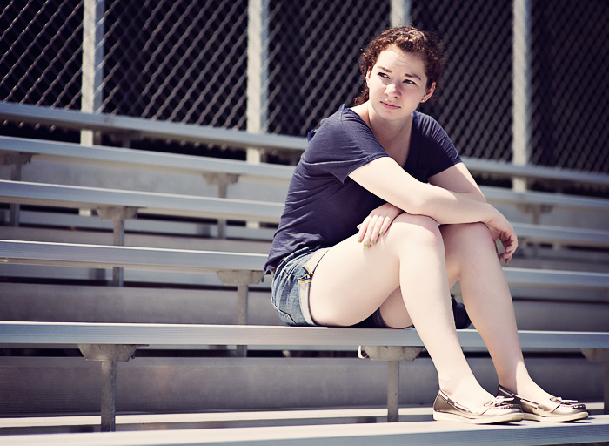
NO OPT-OUT
WE OPT-IN!

Slide 30
Be ACTIVE!
Physical Education Opt-Out
  THIS IS NOT AN OPTION.
    You cannot “take a zero”.
    You WILL be ACTIVE EVERY CLASS PERIOD.
There will be NO EATING in ANY PHYSICAL EDUCATION AREA.

Slide 31

GET MOVING!

